Slide 1
FINAL PROJECT PRESENTATION

Slide 2
ANALYSIS OF HUMAN SPEECH & TEXT EMOTION USING CNN
Team Members:
Aman Singh - A20491333
Radhika Malhotra - A20491601
Kandalam Sai Sree - A20496672
Professor:
Dr. Yan Yan
Department of Computer Science
Illinois Institute of Technology

Slide 3
Motivation
The way humans express their opinion is truly based on the emotions they carry in day-to-day activities. Human emotions play a vital role in every-one's life.
The communication among different aspects depends on their emotions and the way they are conveying them. These emotions in any sort of communication can be detected using several factors such as sound pressure level(SPL), pitch, tone, timbre and time gap between every word.

Slide 4

Sentiment analysis is a powerful marketing tool that enables product managers to understand customer emotions in their marketing campaigns. It is an important factor when it comes to product and brand recognition, customer loyalty, customer satisfaction, advertising and promotion's success, and product acceptance.
As we can see here, we provide samples of two text samples and 2 speech samples, to help understand these different sentiments (as provided to our models for training and later for testing).
Oh my God, he’s lost it. He’s totally lost it. – (Negative Emotion)
This is amazing. – (Positive Emotion)

Slide 5
The main aspect that can be used to detect emotion utilizes a gold standard (great or excellent example of it’s kind) of list of features that can be defined from human experts who are consistent in their speech.
Analyzing the emotion has different applications. The applications can be improvised by considering modes of data which is used in emotional analysis should not have any restrictions to detection either speech or text.

Slide 6
Problem Description
We have the ability to investigate textual content and speech to understand feelings can result in advanced programs.
We are taking into consideration the previous activities or researches that took place so as to create a model with better detection activities.
We’ve tried to use a module technique that investigates speech content, i.e., samples one after the other, and detect emotional levels.

Slide 7
To implement the stated module from input with special processing techniques for speech and textual information, a one-directional Convolutional Neural Network (CNN) is used.
We use samples from datasets called IEMOCAP and REVDES to train and improve the quality of detection.

Slide 8
This task presently aims at distinguishing among eight exclusive forms of feelings which can be correctly carried out for marketing analysis purposes or assistive generation consisting of chat bots, to offer a far extra natural and customized approach to a response.
0 = neutral, 1 = calm, 2 = happy, 3 = sad, 4 = angry, 5 = fearful, 6 = disgust, 7 = surprised

Slide 9
Implementation
A one-dimensional convolution neural network architecture is used in our speech and text emotion analysis models. This model is implemented in three stages: preprocessing, model building, and model fitting.
DATASET:
Our speech model is based on a combination of REVDESS and IEMOCAP datasets. Both datasets comprise audio recordings, which we utilized in our Model.
The Text Model dataset exists in the form of a.csv file that contains a tabulation of English sentences as well as a pre-labeled emotion for each one.

Slide 10
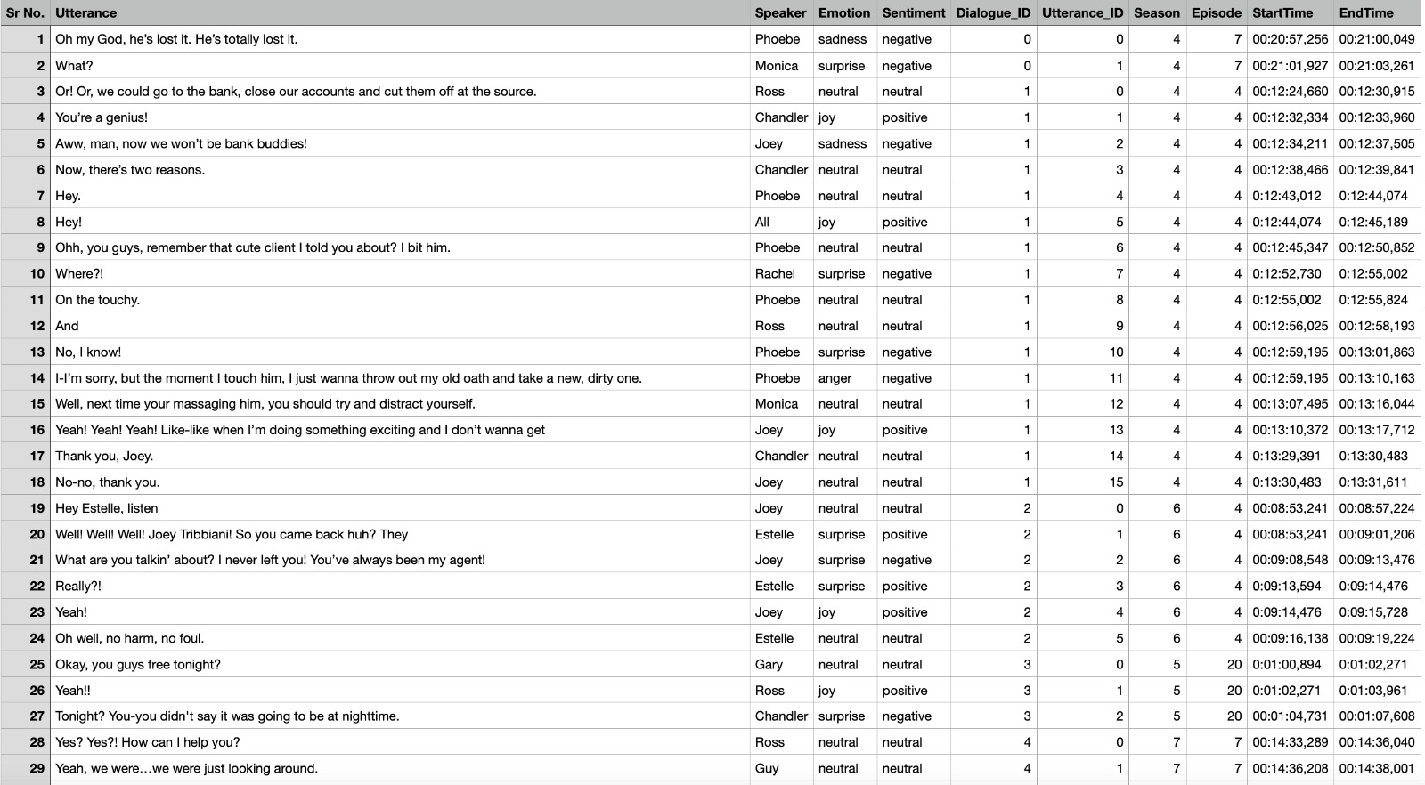
Text Dataset

Slide 11

Speech Dataset

Slide 12
PREPROCESSING:
The first step in working with audio files is how to turn an audio wave into numbers so that it can be fed into your machine learning algorithm. We have used MFCC to catch Audio features.
For text analysis, each word in the dataset needs to be attached with a respective weight. This process is called word embedding and ‘Glove.6d’ is employed for the same. Glove is open-source file which contains over 10,000 English words with some weight vector already added to it.
Both, the text and speech dataset are then split into training and testing dataset with a 20% split and stored in a data frame upon which label encoding is performed.

Slide 13
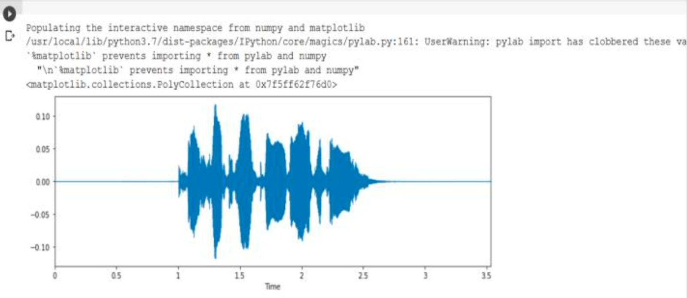
Spectrogram plotted for an audio file from our proposed model

Slide 14
MODEL BUILDING:
1D CNN kernel runs along one dimension and can take advantage of the audio wave’s time structure while providing good results for the text model too. Our proposed model is a multi-layered 1D CNN model.
These layers are Input layer, dense layer, Flatten layer, Softmax Layer, embedding layer results of which pass through a maxpooling layer for better classifications.
Other configurations of the model are loss = ‘categorical_crossentropy’, optimizer = ‘Adam’, metrics = [‘accuracy’].

Slide 15
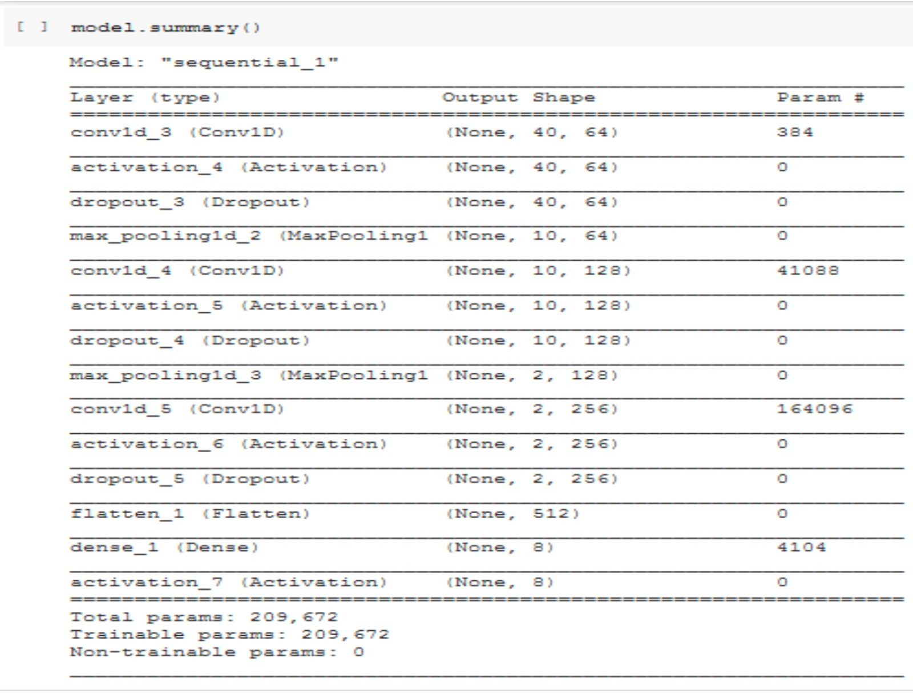
CNN Model Summary

Slide 16
MODEL TRAINING:
Our model gave its best result when trained with a batch size of 8 and 350 Epoch for speech model.
For obtaining the highest accuracy, alteration in the Adam optimizer default is made from 10% to 1%. Our speech model produced an accuracy of 65%.
The model is then converted and saved in an h5 format and random inputs are tested. Our model successfully classifies speech and text input into 8 different emotions- Happy, sad, disgust, calm, fearful, angry, surprised and neutral.

Slide 17
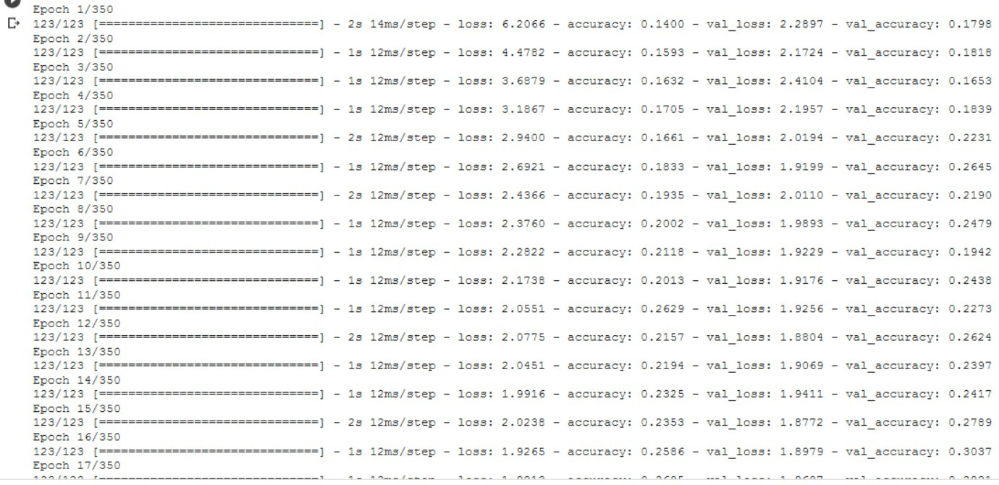
Speech Model Training

Slide 18
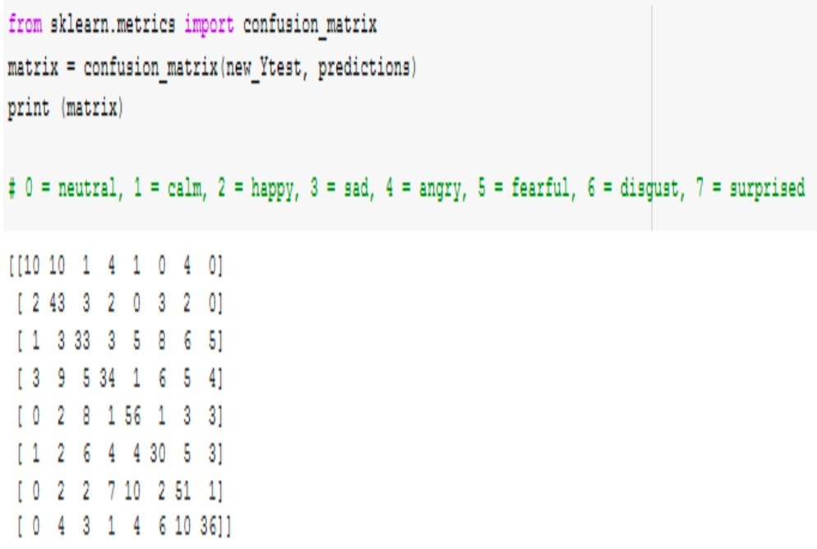
Results

Slide 19
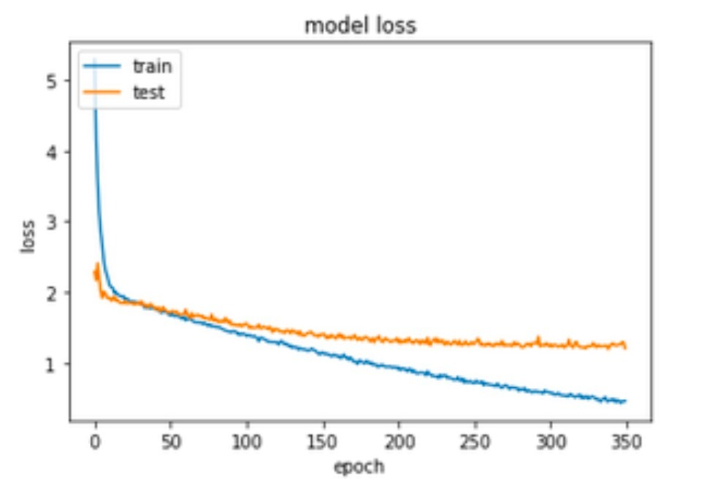

Slide 20
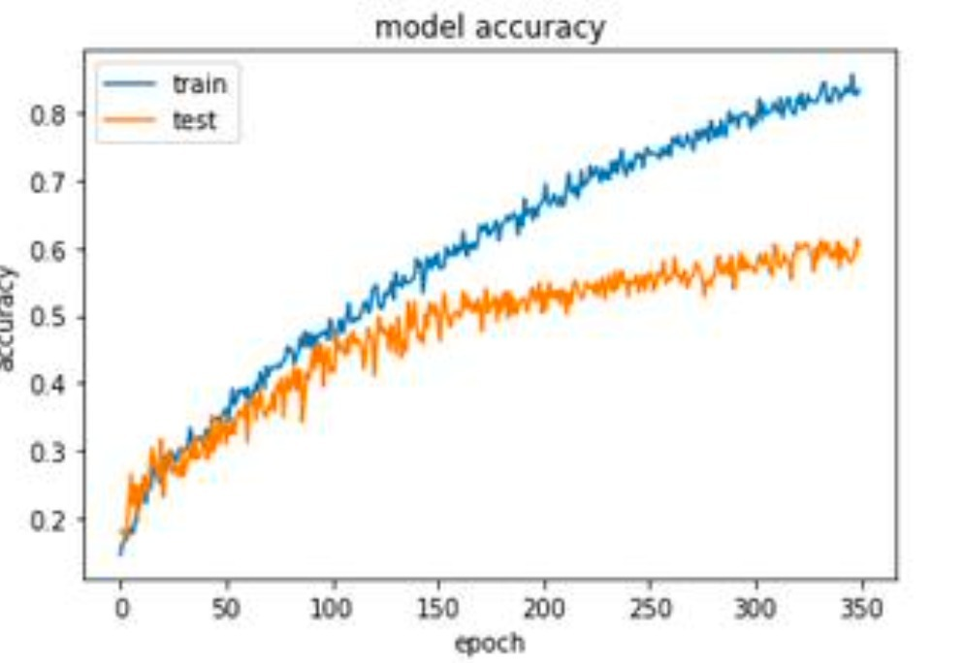

Slide 21
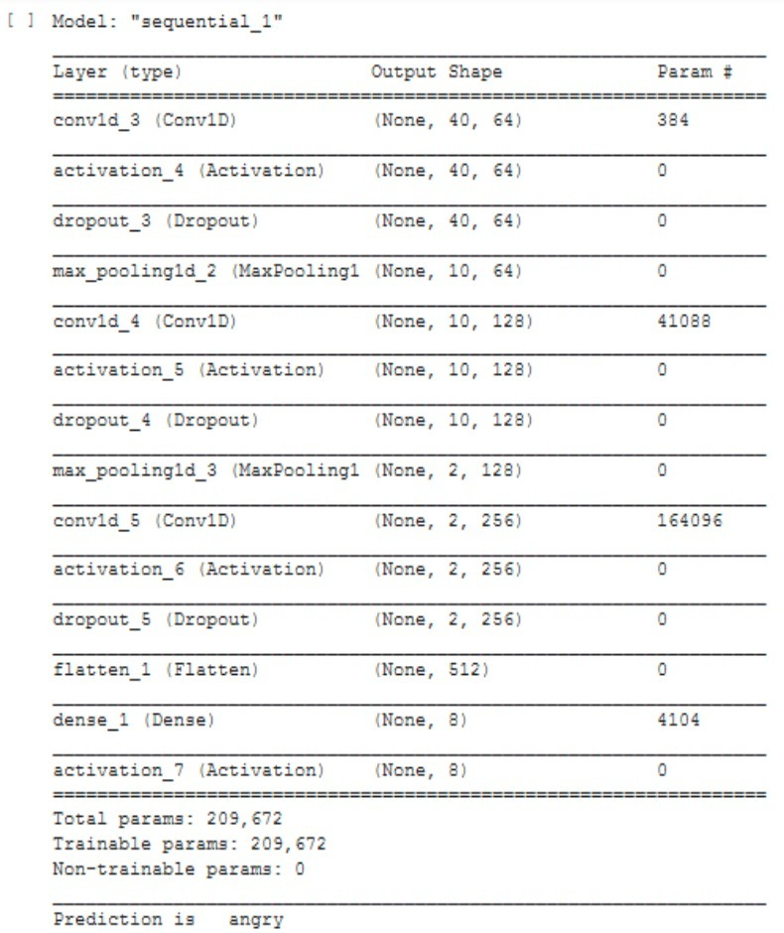

Slide 22
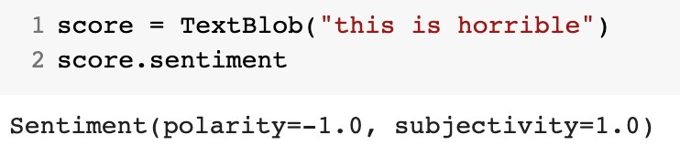

Slide 23
Comparison b/w Existing and Proposed Model
EXISTING MODEL | PROPOSED MODEL
Multi-model emotion on IEMOCAP dataset using deep learning. Accuracy: 54 - 64.78% | Human speech and text emotion recognition using CNN. Accuracy: 65 - 75%
Speech emotion recognition with heterogeneous features unification of deep neural network. Accuracy: 64% | Human speech and text emotion recognition using CNN. Accuracy: 65%

Slide 24
Conclusion
All the current technologies have become a major part in our life. Every thing is depending on many technologies. Machine Learning and Artificial Intelligence play a major role in our life cycle. Many of the lives are also saved because of these technologies.
In this project we tried to work on the major topic currently trending everywhere. We were able to successfully create two deep learning model which when provided with suitable inputs i.e. .wave extension files and .csv files can classify and analyze between 7 different emotions viz. calm, angry, surprised, sad, neutral, disgust, happy.

Slide 25
Currently these models are capable of predicting the emotion of voice inputs from a user with an efficient accuracy but a little human effort is required for the preprocessing. We believe that with a more powerful system and a varied dataset the results of these modules can be improved to an extent that they can be implemented in real world problems and evolve into a larger AI.
In the future, we can maybe try to figure out other algorithms that can provide an accuracy even greater than 80%.

Slide 26
References
[1] B. Dasgupta Poorna, Detection and Analysis of Human Emotions through Voice and Speech Pattern Processing, International Journal of Computer Trends and Technology (IJCTT)– Volume 52 Number 1 October 2017.
[2] C. Hutto, E. Gilbert "2.3 VADER: A Parsimonious Rule-based Model for Sentiment Analysis of Social Media Text (2015)" published in The International AAAI Conference on Web and Social Media - 2014
[3] D. Ramalingam, V. Sharma, P. Zar, "Study of Depression Analysis using Machine Learning Techniques " in International Journal of Innovative Technology and Exploring Engineering (IJITEE )ISSN: 2278-3075, Volume-8, Issue-7C2, May 2019.
[4] T. Pandurangan , " Emotion Analysis based on Real Time Human Voice Tones " on 2017/06/07
[5] Jiang ,Wang , Jin , X. Han and C. Li , " Speech Emotion Recognition with Heterogeneous Feature Unification of Deep Neural Network " in Sensors 2019, 19, 2730; doi:10.3390/s19122730

Slide 27
[6] S. Tripathi, A. Kumar, A. Ramesh, C. Singh, P. Yenigalla , " Deep Learning based Emotion Recognition System Using Speech Features and Transcriptions" accepted in CICLing:International Conference on Computer Linguistics and Intelligent Text Processing, 2019
[7] S. Kamble, A. Joshi, " Hate Speech Detection from Code-mixed Hindi-English Tweets Using Deep Learning Models" presented in the 15th International Conference on Natural Language Processing (ICON-2018)
[8] Haoxiang, Wang. "Emotional Analysis of Bogus Statistics in Social Media." Journal of Ubiquitous Computing and Communication Technologies (UCCT) 2, no. 03 (2020): 178-186.
[9] Mitra, Ayushi. "Sentiment Analysis Using Machine Learning Approaches (Lexicon based on movie review dataset)." Journal of Ubiquitous Computing and Communication Technologies (UCCT) 2, no. 03 (2020): 145-152. 46
[10] S. Tripathi, H. Beigi,S. Tripathi, " Multi-Modal Emotion recognition on IEMOCAP Dataset using Deep Learning" arXiv:1804.05788v3;2018

